Slide 1
Practical Issues in Machine Learning
NLP II 2025
Assoc. Prof. Attapol Thamrongrattanarit

Slide 2
Machine Learning so far
Naive Bayes: representation, learning, and prediction
Logistic Regression: representation, learning, and prediction
Linguistic theory for a specific task for sentiment analysis

Slide 3
Practical Issues
Multi-label vs Multi-class
Overfitting and underfitting: Regularization

Slide 4
Practical Issues
Multi-label vs Multi-class
Overfitting and underfitting: Regularization

Slide 5
Multi-class vs multi-label
Multi-class classification assumes that we label text input with one out of the pre-defined k classes (labels or categories). Also called k-way classification
Example?
Multi-label classification assumes that we label text input with at least one of the pre-defined k classes.
Each class is not mutually exclusive. Example?
There can be multiple answers.

Slide 6
Example
Book genre classification
Product classification
Social media content classification
News article classification
Customer feedback classification

Slide 7
How to deal with multi-label classification
Suggestion classifier
Complaint classifier
Question classifier
Praise classifier
1
0
0
1
ชื่นชมพนักงานตอบกลับเร็วมาก ๆ แต่ว่าพนักงานควรจะได้รับแจ้งเกี่ยวกับ product ใหม่เร็วกว่านี้
binary classifiers
four independent binary results

Slide 8
Multi-class (k-way classification) vs Multi-label
Multi-class classification is done with one single model. But we have to simplify our analysis to one class per text input and design the label set to be mutually exclusive (เป็นอันนึงแล้วห้ามเป็นอีกอันนึง).
Multi-label classification is done with k models. We have to train k models on the same dataset. This is a more complex solution. The choice is up to the use case.

Slide 9
Practical Issues
Multi-label vs Multi-class
Overfitting and underfitting: Regularization

Slide 10
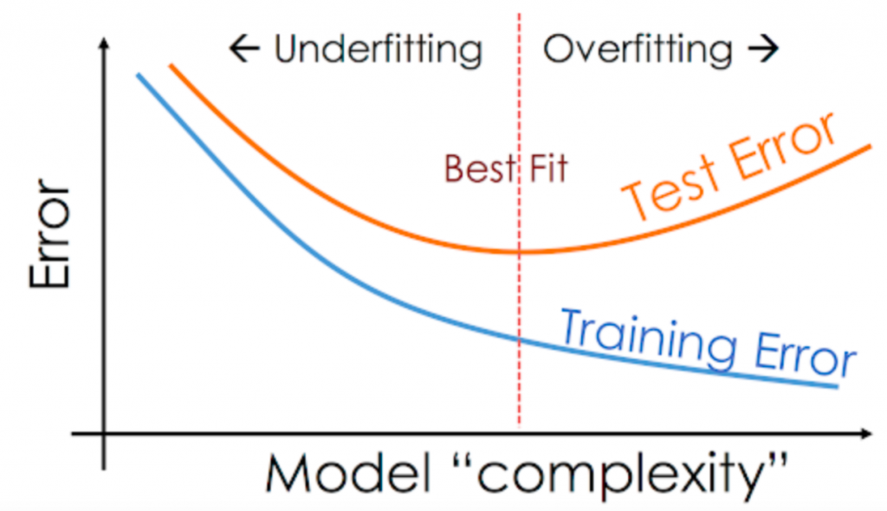
The Tension
Adding more features (more complexity) reduces the test error to a certain point and then increases it.

Slide 11
Consider these features: non-conflicting features
Text | Label (Y) | predictable | and | boring | very | few | laughs | short | but | powerful | fun | good
predictable and boring | negative | 1 | 1 | 1
very few laughs | negative |  |  |  | 1 | 1 | 1
short but boring | negative |  |  | 1 |  |  |  | 1 | 1
very very powerful | positive |  |  |  | 2 |  |  |  |  | 1
fun and good good laughs | positive |  | 1 |  |  |  | 1 |  |  |  | 1 | 2

Slide 12
Overfitting
Text | Label (Y) | predictable | and | boring | very | few | laughs | short | but | powerful | fun | good
predictable and boring | negative | 1 | 1 | 1
very few laughs | negative |  |  |  | 1 | 1 | 1
short but boring | negative |  |  | 1 |  |  |  | 1 | 1
very very powerful | positive |  |  |  | 2 |  |  |  |  | 1
fun and good good laughs | positive |  | 1 |  |  |  | 1 |  |  |  | 1 | 2
Since there is none (or too little) contradicting evidence from the dataset, the loss function decreases if we make the weights for these non-conflicting features really really big. Consider "boring but many laughs"

Slide 13
Overfitting
Overfitting refers to the situation where the model fits too closely to the training data, and as a result, it doesn't generalize to unseen data. This happens when we have a lot of features (e.g. bag-of-word features)
Underfitting refers to the situation where the model is too simple to fit well to the training data, and as a result, it performs poorly on unseen data. This happens when we have too few features or the features are ineffective.

Slide 14
Regularization
Regularization is a technique to mitigate the problem of overfitting.
One of the most popular ways is L2-regularization where we have to 'pay' for the weights to make the model less confident about any single feature. The larger the weights, the more expensive.

Slide 15
Consider these features: non-conflicting features
Text | Label (Y) | predictable | and | boring | very | few | laughs | short | but | powerful | fun | good
predictable and boring | negative | 1 | 1 | 1
very few laughs | negative |  |  |  | 1 | 1 | 1
short but boring | negative |  |  | 1 |  |  |  | 1 | 1
very very powerful | positive |  |  |  | 2 |  |  |  |  | 1
fun and good good laughs | positive |  | 1 |  |  |  | 1 |  |  |  | 1 | 2

Slide 16
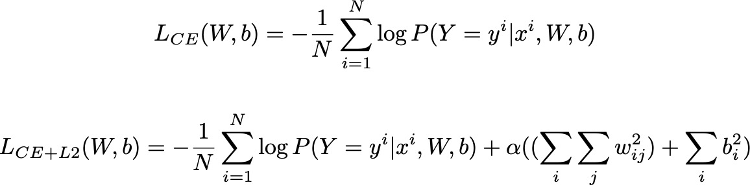
L2 Regularization
Weight matrix (W) | bias | 'against' | 'love' | text length
positive | 0.15 | -2 | -1 | 0.0004
negative | -0.2 | 2 | -0.2 | 0.005
neutral | 1 | -1 | 0.4 | -0.00001
Notes:
$$L_{CE }(W,b) = -\frac{1}{N}\sum_{i=1}^{N} \log P(Y=y^i|x^i, W, b)$$
$$L_{CE+L2}(W,b) = -\frac{1}{N}\sum_{i=1}^{N} \log P(Y=y^i|x^i, W, b) + \alpha((\sum_i\sum_j w_{ij}^2) + \sum_ib_i^2) $$

